Slide 1

ANZ PROJECT DESCRIPTION
By Oyelade David

Slide 2
Project Objectives
01
02
About the project and task
The Dataset: Description and dataset explanation
Exploratory and Visualization data analysis
03

Slide 3
About the Project and Task
Performing Exploratory Data Analysis.
Segment the dataset and draw unique insights, including visualisation of the transaction volume and assessing the effect of any outliers.

Slide 4
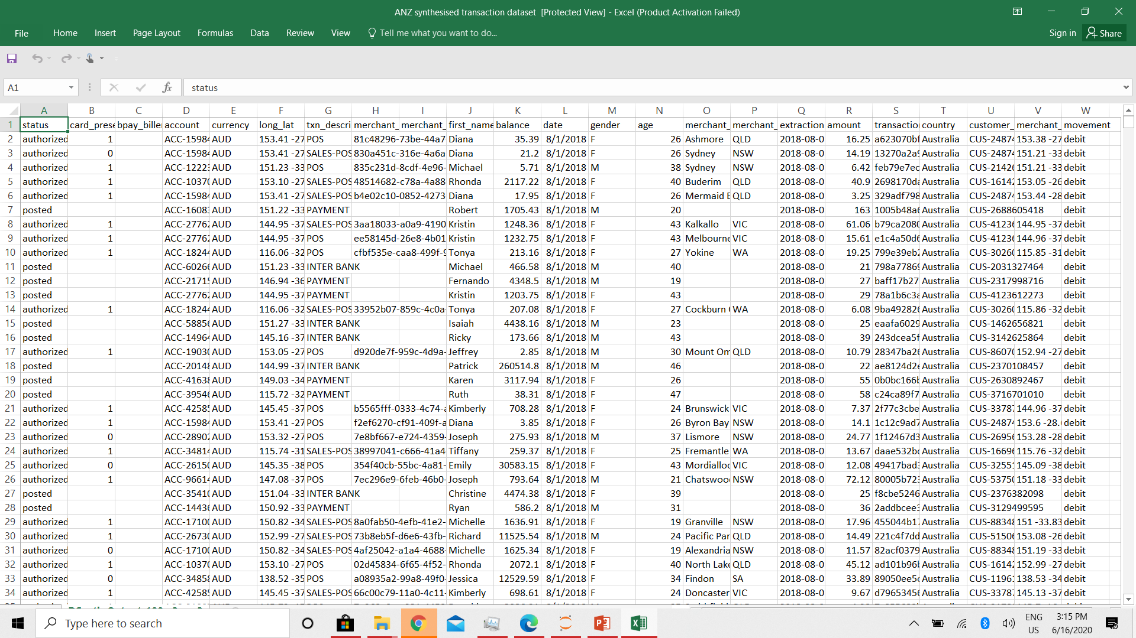
The Dataset
The synthesised transaction dataset contains 3 months’ worth of transactions for 100 hypothetical customers. It contains purchases, recurring transactions, and salary transactions.
The dataset is designed to simulate realistic transaction behaviours that are observed in ANZ’s real transaction data, so many of the insights you can gather from the tasks below will be genuine.

Slide 5
Exploratory data analysis
01
Total number of authorized and posted status
I discovered that a total of authorized status were 7717 while the posted status were 4326 for the 3 months business transactions.
02
Total number of transactions made on each day
I observed that there was an increase in the daily transaction rate. This trend, if sustained will result in significant financial growth and profit maximization for ANZ.
03
Total number of transactions made by each customer
Considering the range of the Customers transactions, the Customer with ID CUS-2487424745 had the highest transaction (578) while the Customer with ID CUS-1739931018 had the lowest transaction (25).
I suggest a customer retention plan for the customer with the highest transaction rate. For customers with low transaction, I suggest the organization should create more values to attract the customers to patronize the organization.

Slide 6
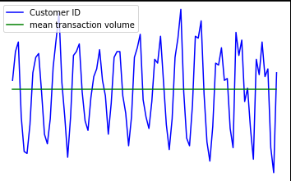
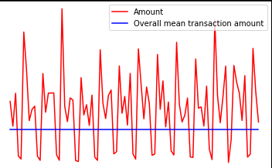
Visualization Data Analysis
Transaction volume made by customers each day
The overall average transaction amount

Slide 7
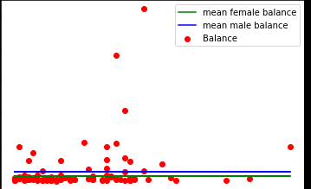
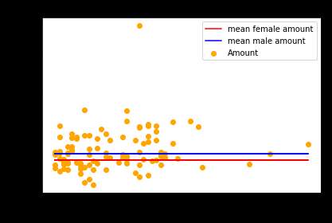
Visualization Data Analysis
The average customer balance and payment amount generated by Age and Gender for the month of August
For August:
For August:

Slide 8
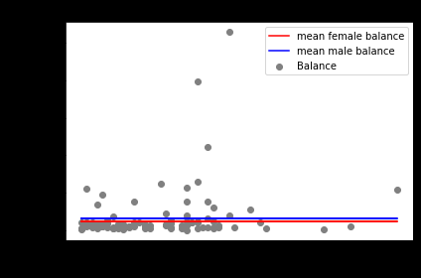
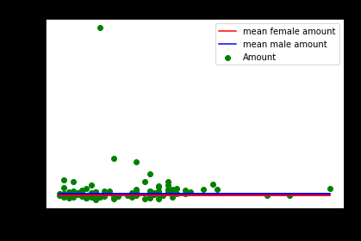
Visualization Data Analysis
The average customer balance and payment amount generated by Age and Gender for the month of September
For September:
For September:

Slide 9
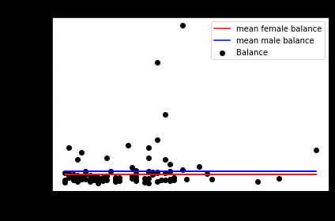
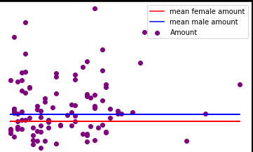
Visualization Data Analysis
The average customer balance and payment amount generated by Age and Gender for the month of October
For October:
For October:

